Slide 1
Threat Hunting RAG System
Phishing threat hunting
Aviad Nissim
06.08.24

Slide 2
Agenda
Introduction
Overview
How to use
Examples
High-Level & Detailed Design
Conclusion and Q&A

Slide 3
Introduction
Threat Hunting RAG System
A Retrieval-Augmented Generation (RAG) system for phishing threat hunting that analyzes email datasets through natural language queries and returns ranked, explainable threat detections

Slide 4
Objectives
Objectives
System performs hybrid (semantic + keyword) retrieval
Extracts threat features
  Scores each email
  Produces human + optional JSON explanations
  Refinement lets you quickly narrow results without re-running vector search

Slide 5

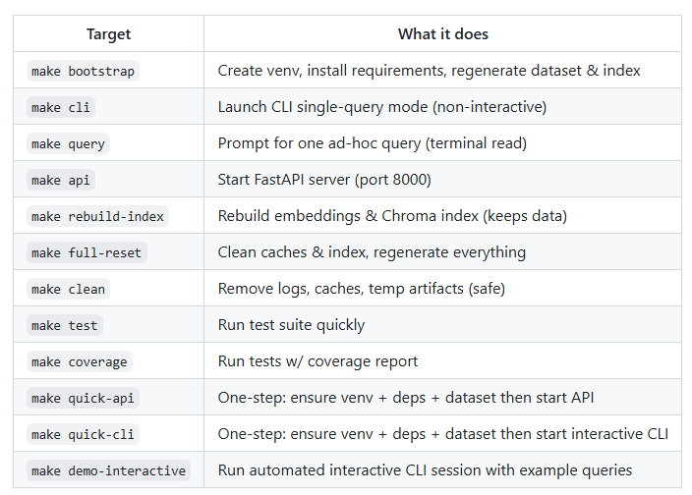
How to use – Quick Start (Makefile)

Slide 6
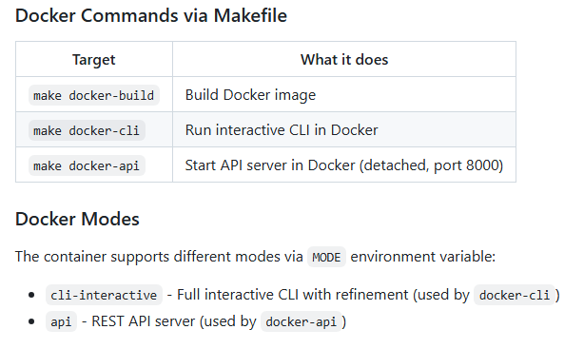
How to use – Docker Commands via Makefile

Slide 7
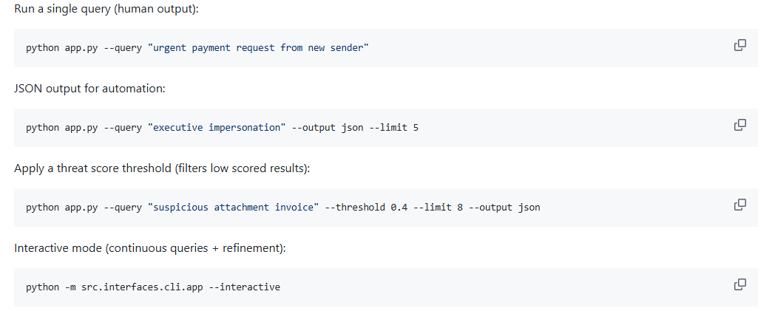
How to use – Using the CLI

Slide 8
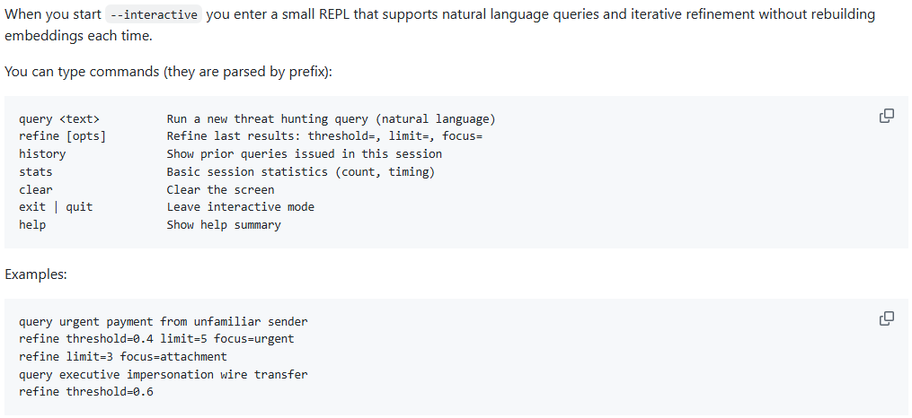
How to use – Interactive CLI Capabilities

Slide 9
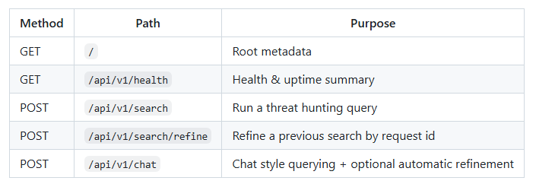
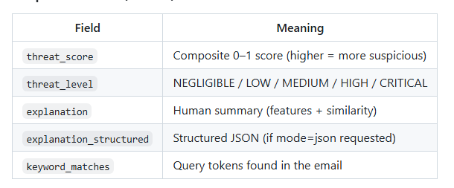
How to use – Endpoints

Slide 10
Example CLI
help - Show available commands
  query <text> - Run threat hunting query
  refine [opts] - Refine last results (threshold=, limit=, focus=)
  history - Show query history
  stats - Show session statistics
  clear - Clear screen
  exit/quit - Exit interactive mode
  🔍 threat-hunt> Find emails with suspicious attachment names
  🔍 Processing query: 'Find emails with suspicious attachment names'
  Method: hybrid, Max results: 10
  ⏱️ Processed in 9.218s | Found 10 results
  ================================================================================

Slide 11
Example CLI
  ℹ️ RESULT #1 - LOW RISK (Score: 0.303)
  From: no-reply@verify-now.com
  Subject: Suspicious Activity Detected - Verify Now
  Time: 2025-11-13 04:43:00
  💡 Analysis:
  Overview:
  - Threat Level: LOW (0.303)
  - Similarity=0.0 | Confidence: 0.43 | Rank: 1
  Key Indicators:
  - urgent_language 0.8 – Urgent wording requesting immediate action
  - link_suspicious 0.6 – Link appears obfuscated or mismatched

Slide 12
Example CLI
  Risk Summary:
  - Multiple moderate indicators; monitor and verify via trusted channel
  Recommended Action:
  - Low immediate risk; continue monitoring for patterns.
  Analysis Detail:
  ⚠️ HIGH RISK INDICATORS:
  • Contains urgent language requiring immediate action (confidence: 80.0%)
  • Contains suspicious or potentially malicious links (confidence: 60.0%)
  ⚡ MODERATE RISK INDICATORS:
  • Sent outside typical business hours (confidence: 30.0%)
  Email from: no-reply@verify-now.com
  Subject: Suspicious Activity Detected - Verify Now...
  🎯 Confidence: 43.0%
  🔑 Keywords: suspicious

Slide 13
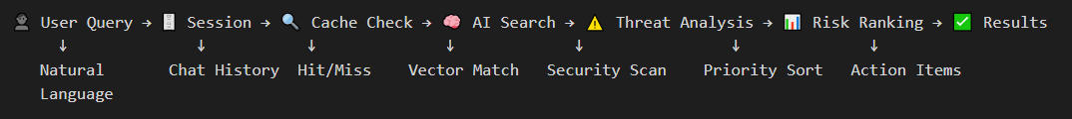
End to end user flow

Slide 14
End to end user flow
Step 1: User Input 👤
User types: "Find urgent payment requests from new senders“
🎯 What happens: Convert natural language security question into searchable format
💡 Real examples:
"phishing emails with attachments"
"suspicious login attempts"
"invoices from unknown domains"

Slide 15
End to end user flow
Step 2: Interface Processing
🖥️ CLI/API receives query
├── CLI: python -m src.interfaces.cli.app --query "urgent payment"
└── API: POST /api/v1/search {"text": "urgent payment", "limit": 10}
🎯 What happens: Validate input and set search parameters and route to processing pipeline
💡 Example transformation:
Input: "urgent payment --format json"
Output: SearchQuery(text="urgent payment", limit=10, format="json")

Slide 16
End to end user flow
Step 2: Interface Processing
💾 Session Store Cache (Chat mode only):
🗄️ Check: SessionStore.get_session("analyst_jane_session_456")
├── 🟢 HIT → Load chat history: [{"query": "phishing", "results": [...]}, ...]
└── 🔴 MISS → Create new session ID
🔍 Cache Purpose: Maintain chat history for follow-up questions
💡 Example: Previous query context helps with "show me more like the first result"

Slide 17
End to end user flow
Step 3: Pipeline Initialization
⚙️ ThreatHuntingPipeline.process_query()
└── SearchQuery(text="urgent payment", method=HYBRID, limit=10)
🎯 Objective: Structure query with proper search parameters
💡 Example: HYBRID = semantic search + keyword matching for "urgent" + "payment"

Slide 18
End to end user flow
Step 4: Query Results Cache Check
🔍 QueryResultsCache.get("sha256:abc123def...")
├── HIT → Return cached results (20ms) ✅ SKIP TO STEP 10
└── MISS → Continue to search ➡️
🎯 Objective: Avoid expensive recomputation for identical queries
🔍 Cache Details: TTL+LRU cache storing complete pipeline results
💡 Example: Hash "urgent payment|HYBRID|limit:10" → cached result with 10 emails

Slide 19
End to end user flow
Step 5: Vector Search with Embedding Cache
🧠 UnifiedSearchService.search()
├── Query Embedding Generation:
│ ├── 💾 Check: "urgent_payment_req.pkl"
│ ├── 🟢 HIT → Load
│ └── 🔴 MISS → SentenceTransformer.encode() + save to disk
├── ChromaDB cosine similarity: 0.87, 0.82, 0.76...
└── Return top 50 emails: [email_001, email_047, ...]
🎯 Objective: Find emails semantically similar to query concept
🔍 Embedding Cache: Disk-based cache of computed vectors (200+ files)
💡 Example: "urgent payment" vector matches "immediate wire transfer" content

Slide 20
End to end user flow
Step 6: Security Threat Analysis ⚠️
ThreatAnalysisService analyzes emails:
📧 Email_047: "URGENT: Wire Transfer Required Today"
├── 🔍 Urgency Detection: "URGENT" → score: 0.9/1.0
├── 👤 Sender Analysis:
│ ├── 💾 Domain Cache: Check "newbank-corp.com"
│ ├── 🟢 HIT → {created: 2_days_ago, reputation: unknown}
│ └── New sender risk: 0.95/1.0
├── 📎 Attachment Scan:
│ ├── 💾 Feature Cache: Check "invoice.pdf.exe"
│ ├── 🔴 MISS → Analyze file type + cache result
│ └── Malicious extension detected: 0.9/1.0
└── 🎯 Combined Threat Score: (0.9 + 0.95 + 0.9) / 3 = 0.92 → HIGH RISK
🎯 What happens: Assess real security risk beyond just content similarity

Slide 21
End to end user flow
Step 7: Intelligent Ranking 📊
Risk-Based Ranking Algorithm:
├── Email_047: AI_match(0.87) + Threat(0.92) + Keywords(0.1) = Final: 0.89
├── Email_001: AI_match(0.82) + Threat(0.65) + Keywords(0.2) = Final: 0.72
├── Email_156: AI_match(0.76) + Threat(0.45) + Keywords(0.0) = Final: 0.63
└── Sorted Results: [Email_047, Email_001, Email_156, ...]
🎯 What happens: Prioritize emails that are both relevant AND dangerous
🎨 Risk Levels:
🔴 CRITICAL (0.9-1.0): Investigate immediately
🟠 HIGH (0.7-0.9): Likely malicious - priority review
🟡 MEDIUM (0.5-0.7): Suspicious - worth checking
🟢 LOW (0.0-0.5): Probably safe - monitor only

Slide 22
End to end user flow
Step 8: Result Caching 💾
QueryResultsCache.put("abc123def...", complete_results_with_rankings)
🎯 What happens: Save complete analysis for future identical queries
💡 What gets cached: Emails + threat scores + explanations + timing
🕒 Cache duration: 1 hour (configurable)

Slide 23
End to end user flow
Step 9: Format Response
📤 Format results based on interface
├── CLI: | Email ID | Threat | Score | Reason |
│ | email_047| HIGH | 0.88 | New domain + urgent |
└── API: {"results": [{"email_id": "047", "threat_level": "HIGH"}]}
🎯 Objective: Present results in format suitable for user's workflow
💡 Example: Same data, CLI shows table, API returns JSON structure

Slide 24
End to end user flow
Step 10: Return to User & Session Update
📧 Subject: "URGENT: Wire Transfer Required Today"
│ 📤 From: finance@newbank-corp.com
│ 🚨 Threat Level: HIGH (0.89/1.0)
│ 📎 Attachment: invoice.pdf.exe (🔴 Malicious)
│
│ 🔍 Why This is Suspicious:
│ ✓ Urgent language creates time pressure
│ ✓ Domain 'newbank-corp.com' created 2 days ago
│ ✓ Attachment has double extension (.pdf.exe)
│
│ 👉 Recommended Action: Block sender + quarantine email

Slide 25
End to end user flow
Step 10: Return to User & Session Update
💾 Session Store Update (Chat mode):
SessionStore.append_turn("analyst_jane_session_456", {
query: "urgent payment",
results: [email_047, email_001, email_156, ...],
timestamp: "2025-11-16T10:30:00Z"
}) :

Slide 26
End to end user flow
🔄 Interactive Refinement (Chat Mode)
👤 Follow-up: "Show me only the emails with attachments from those results"
↓
🗄️ SessionStore loads previous results: [email_047, email_001, email_156, ...]
↓
🔍 Smart filtering: results.filter(has_attachments=True) → [email_047, email_033]
↓
💾 SessionStore saves refinement turn
↓
✅ 2 filtered results returned in 8ms (no new AI search needed!)
💡 Why this is good:
No need to re-run expensive AI analysis
Maintains conversation context
Enables rapid threat investigation workflow

Slide 27
What Each Cache Does
Cache | Stores | Why
Query Results | Complete search results | Don't search same thing twice
Chat History | Previous conversations | Remember what you asked before
AI Fingerprints | Text converted to numbers | Don't re-process same text
Domain Info | Website reputation data | Don't look up same domain twice
Similarity Scores | How alike two domains are | Don't recalculate comparisons

Slide 28
What Each Cache Does - Real Example
Cache | What Happens
Query Results | Ask "phishing emails" again → Get instant answe
Chat History | Say "show me more like #3" → Knows what #3 was
AI Fingerprints | See "urgent payment" text → Instantly know it's suspicious
Domain Info | Check "badbank.com" → Remember it's only 2 days old
Similarity Scores | Compare "gooogle.com" vs "google.com" → Remember they're 95% similar

Slide 29
What Each Cache Does - Real Example
Cache | What Happens
Query Results | Ask "phishing emails" again → Get instant answe
Chat History | Say "show me more like #3" → Knows what #3 was
AI Fingerprints | See "urgent payment" text → Instantly know it's suspicious
Domain Info | Check "badbank.com" → Remember it's only 2 days old
Similarity Scores | Compare "gooogle.com" vs "google.com" → Remember they're 95% similar

Slide 30
AI Fingerprints
AI Fingerprints are used for:
Converting your search into numbers the AI can understand
Finding similar emails by comparing number patterns
Building the search database with AI-powered matching

Slide 31
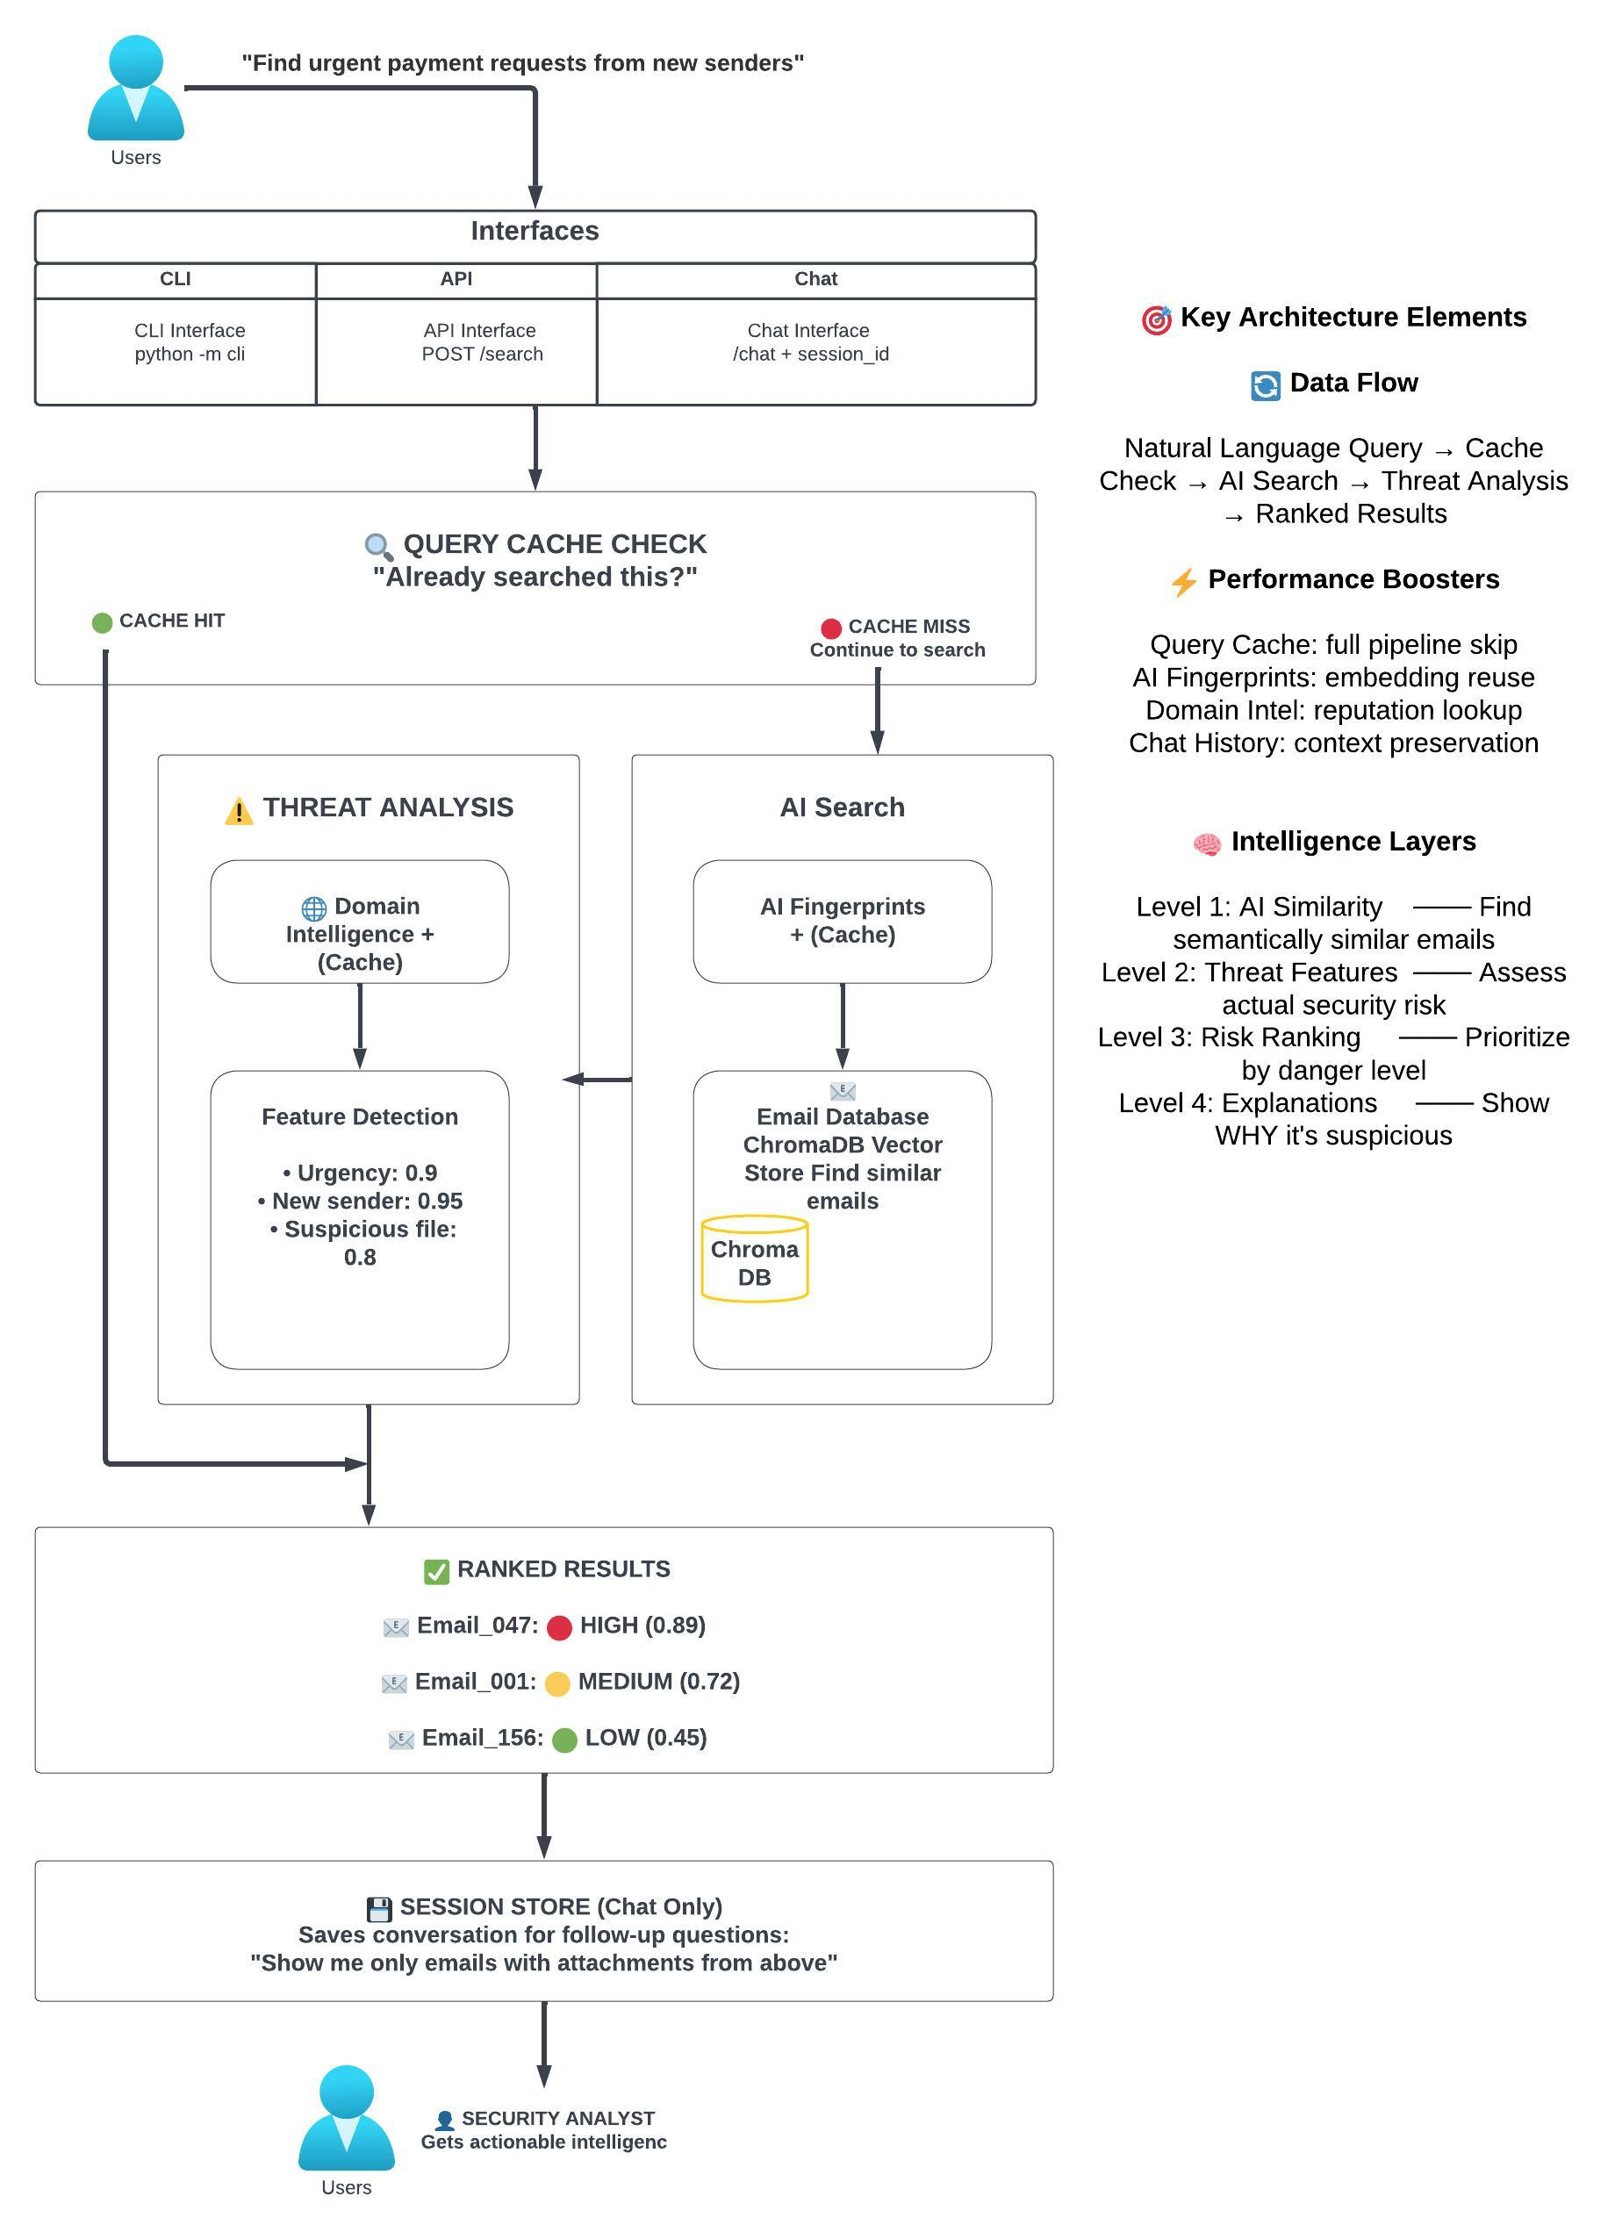
diagram

Slide 32
Thank You!

